Slide 1
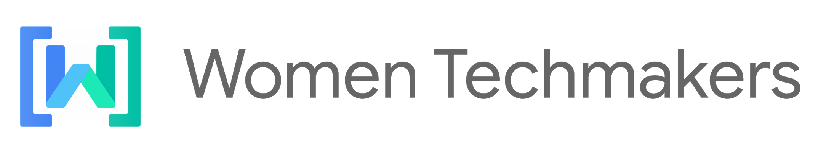
Unconscious Biases
Presented by Hanane Meftahi

Slide 2

Unconscious Biases
What are unconscious biases and how to avoid having them.
Hanane Meftahi
z.meftahi@univ-tiaret.dz

Slide 3
Introduction

Slide 4
Why this topic matters?

Slide 5
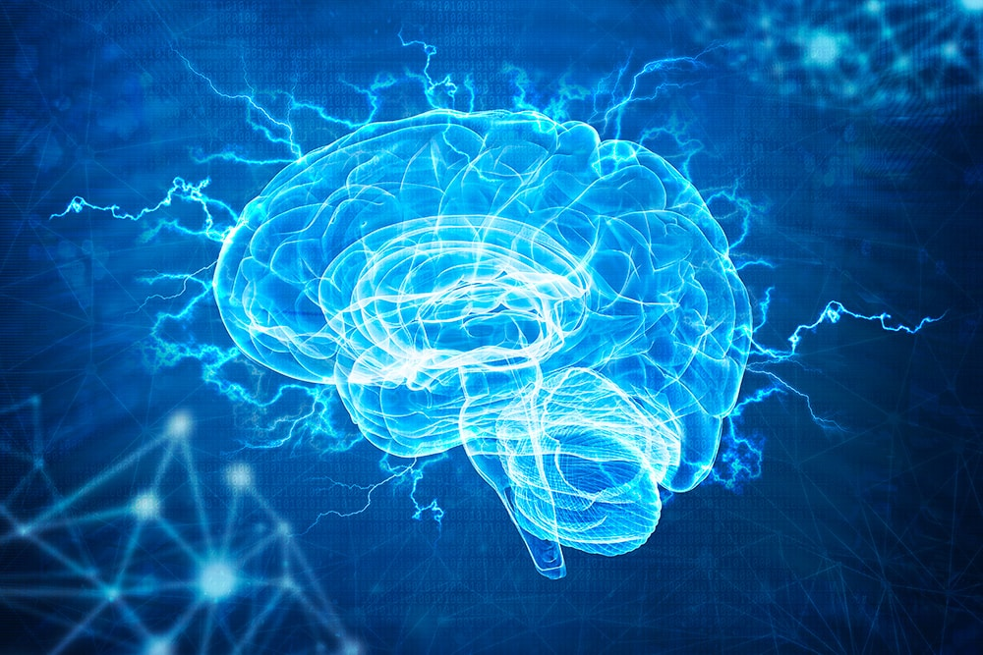
Your unconscious brain processes information 200,000 times faster than your conscious mind. It looks for patterns, and it influences your behaviour whether you like it or not, probably without you even being aware of what’s going on.
Text & diagram slides

Slide 6
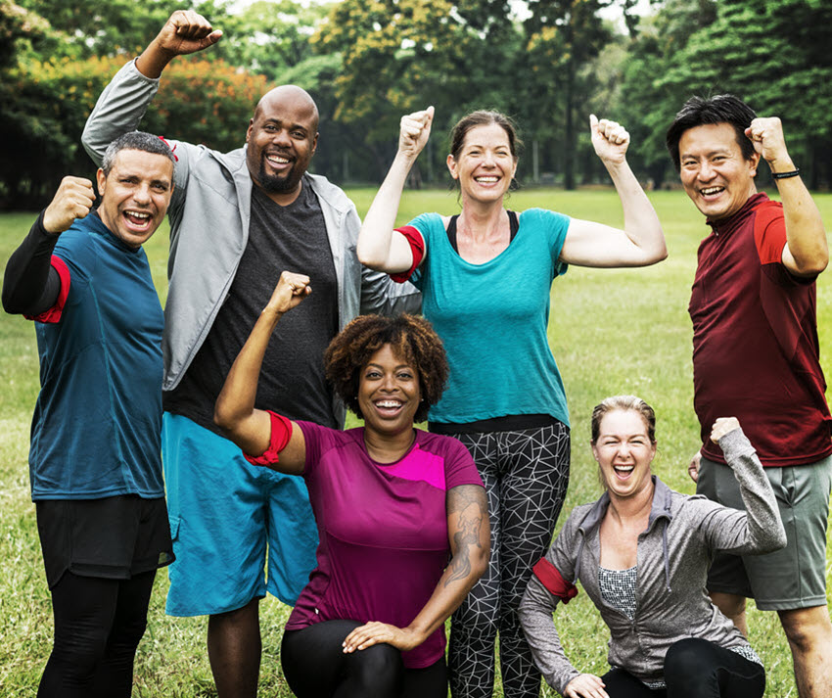
The ability to make quick decisions and judgments can be helpful, but it can also lead to mistakes when those unconscious associations are based on bad information. And we get bad information all the time
Text & diagram slides
Not only can unconscious bias keep you from building a diverse team, it can lead to bad business.

Slide 7
In a business context, your implicit biases could end up leading you to any of the following problems:
Hiring the wrong candidate for a job
Misunderstanding your customers
Causing talented employees to get frustrated and leave
Promoting unsuitable employees beyond their abilities
And much more...

Slide 8

We’re talking here about biases that could affect every decision you make in your business life.

Slide 9
1.What are unconscious biases?

Slide 10
Think back over your life, and try to remember all the information that your brain has taken in since you were born.

Slide 11
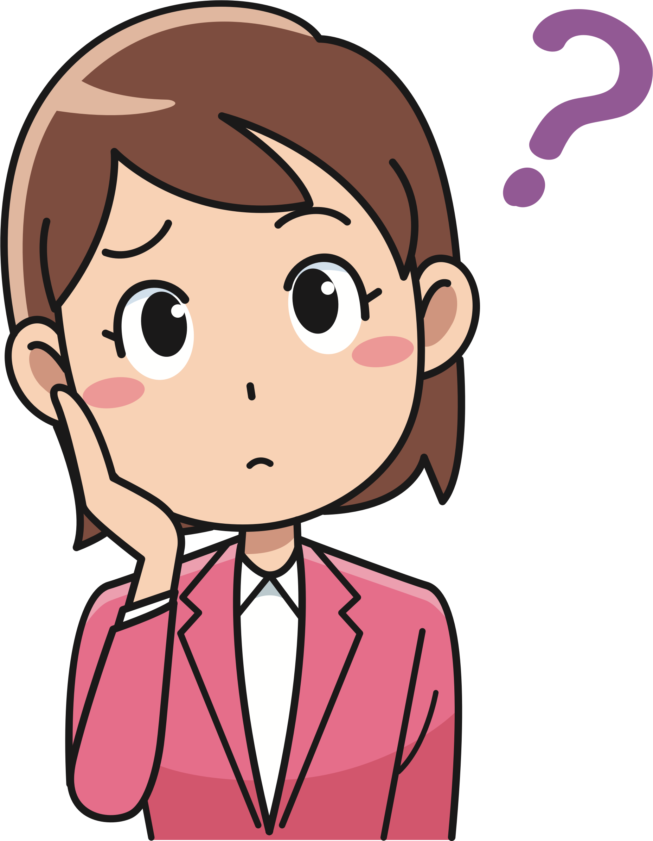
It’s Impossible ,Right !!!

Slide 12

from your parents’ earliest interactions to school, work, TV, the internet, friends, strangers, books, movies and a million other things, your brain has received an unfathomable amount of information,Your brain has used them all to make associations and establish patterns to help you understand how the world works.
Those associations are hard-wired so deep in your brain that you can act without consciously thinking about them at all.

Slide 13

Examples

Slide 14
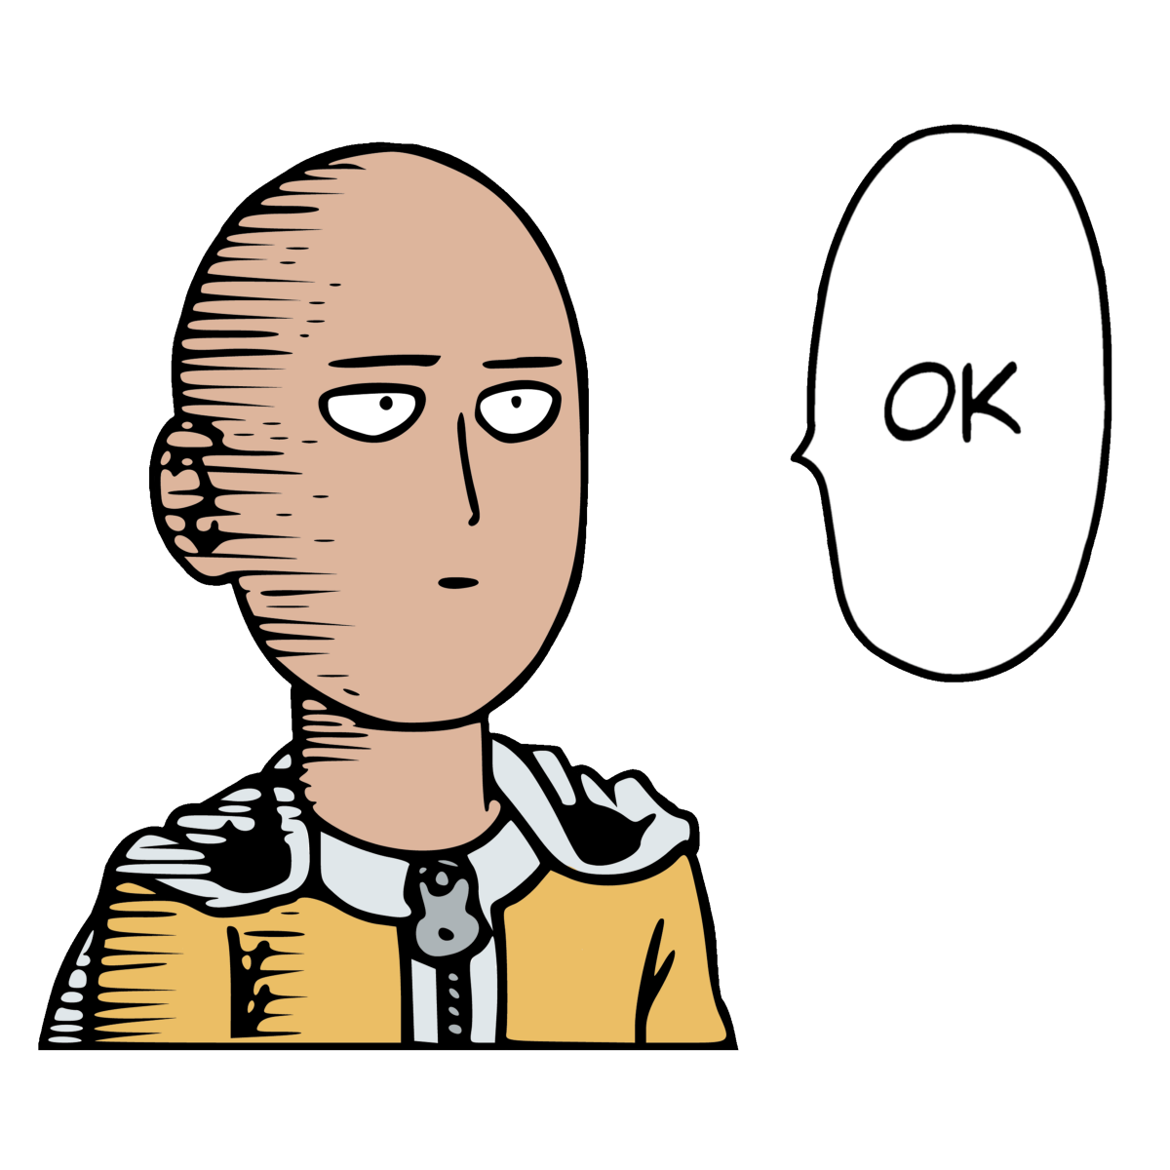
you may unconsciously associate women with family more than working roles

Slide 15

You may believe that older people have less to offer in the workplace (or you may believe the same thing about younger people). These are unconscious biases, also known as implicit biases.

Slide 16

Consciously, you probably know that these kinds of generalisations about large groups of people are baseless, but unconsciously, your brains have formed associations from the morass of information you’ve had to negotiate throughout your life. These unconscious biases could be about gender, race, age, or any of the other dimensions of diversity.

Slide 17
2.Don’t Beat Yourself Up

Slide 18

Having unconscious biases doesn’t make you a bad person. After all, they were formed in an unconscious process based on external information starting way back in early childhood.

Slide 19
3.Effects of unconscious biases in the work place

Slide 20
Our unconscious biases affect every decision we make, and they lead to warped outcomes.
Blond women’s salaries were 7% higher than brunettes or redheads.
For every 1% increase in a woman’s body mass, there was a 0.6% decrease in family income.
“Mature-faced” people had a distinct career advantage over “baby-faced” people.
Both male and female scientists were more likely to hire men, rank them higher in competency than women, and pay them $4,000 more per year than women.
Job applicants with “typically white” names received 50% more callbacks than those with “typically black” names.
...

Slide 21
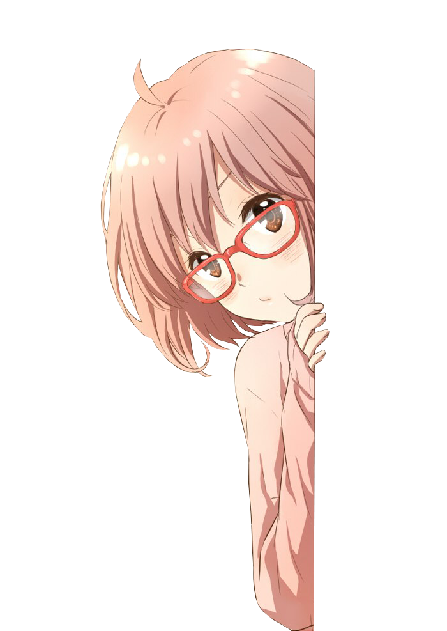
people are getting unfair advantages or disadvantages based on such arbitrary criteria as height and weight, the logical conclusion is that some well-qualified people are missing out on the opportunities they deserve, and their employers are missing out on the talents they could have contributed.And the flipside of that is that some of the people who are being promoted may not be the best candidates.
The effects of unconscious bias also go much further than this. Think about every decision you make in business every single day, and consider that all of those decisions are affected by unconscious brain processes that you don’t understand.

Slide 22
4. How to Avoid Unconscious Bias

Slide 23
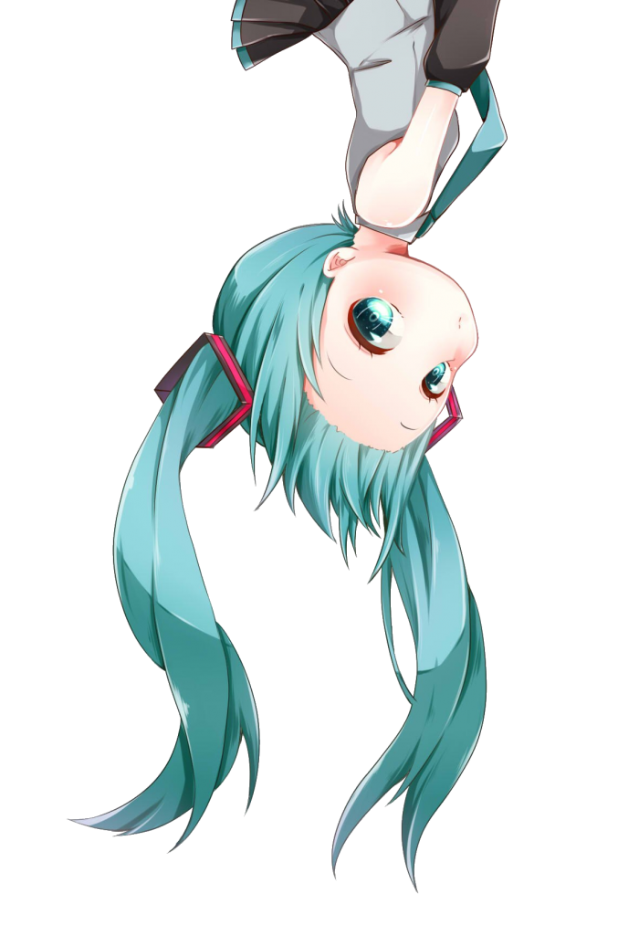
unconscious biases often form at an early age and are reinforced over time, it may not be easy to overcome them, but it's possible.

Slide 24

Increase Your Contact With the Relevant Group
Blind Yourself
Structure Your Decision-Making
Counter the Stereotypes
Be Conscious
………….

Slide 25
5.Conclusion

Slide 26
You’ll never be completely free of bias, but if you work at it over time you'll be able to reduce the effect of unconscious bias on your decision-making and start achieving better outcomes.

Slide 27

どうもありがとうございます。
Domo arigato gozaimasu.
Do you have questions ,Ladies?

